Slide 1
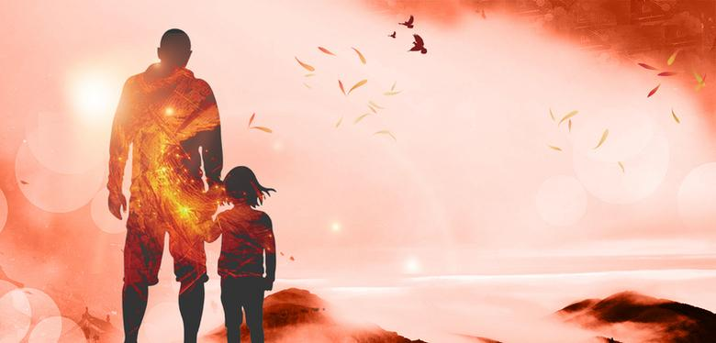
杭二模 续写 讲评

Slide 2
It was on September 5th，my birthday, that we left Cambridge and moved away. We went to the seaside, to our holiday house, which was now to be our permanent home.
I remember the day was cold and grey，with a light rain falling slowly but constantly. My father drove in silence. No one spoke and all we could hear was the sound of the tyres on the wet road.
When we got to the small house near the sea, my mother quietly started to unpack the few things we had brought with us. Carol, Julie and I went down to the beach. We said we were going to look for crabs in the rockpools but actually, we just wanted to get away from our father and his cold silence.
We climbed along the rocks by the side of the beach. Julie and Carol became interested in some shells they found in one of the pools. I wandered away, lost in my private thoughts. It was my birthday, but no one had said “Happy Birthday” to me. I had not received any cards or presents.
I walked down to the seashore, where the waves were breaking lazily against the muddy sand. Suddenly, I saw something green sticking out of the water. I looked at it more carefully. The green thing moved closer and closer to the shore, and when it was almost near enough for me to touch, I realized what it was.
It was a bottle. I went over and picked it up, all the time looking at it. It seemed old, and had no label on it. Then I realized there was something inside. Slowly, I pulled out the wet cork from the top of the bottle. Inside was a piece of paper. With great care, I took out the folded paper and opened it.
Written on it were these words:
“To whomsoever finds this bottle, I promise you a new friend.”

Slide 3
It was on September 5th，my birthday, that we left Cambridge and moved away. We went to the seaside, to our holiday house, which was now to be our permanent home.
I remember the day was cold and grey，with a light rain falling slowly but constantly. My father drove in silence. No one spoke and all we could hear was the sound of the tyres on the wet road.
When we got to the small house near the sea, my mother quietly started to unpack the few things we had brought with us. Carol, Julie and I went down to the beach. We said we were going to look for crabs in the rockpools but actually, we just wanted to get away from our father and his cold silence.
We climbed along the rocks by the side of the beach. Julie and Carol became interested in some shells they found in one of the pools. I wandered away, lost in my private thoughts. It was my birthday, but no one had said “Happy Birthday” to me. I had not received any cards or presents.
I walked down to the seashore, where the waves were breaking lazily against the muddy sand. Suddenly, I saw something green sticking out of the water. I looked at it more carefully. The green thing moved closer and closer to the shore, and when it was almost near enough for me to touch, I realized what it was.
It was a bottle. I went over and picked it up, all the time looking at it. It seemed old, and had no label on it. Then I realized there was something inside. Slowly, I pulled out the wet cork from the top of the bottle. Inside was a piece of paper. With great care, I took out the folded paper and opened it.
Written on it were these words:
“To whomsoever finds this bottle, I promise you a new friend.”
On our way to the holiday house we were
in low spirits

Slide 4
It was on September 5th，my birthday, that we left Cambridge and moved away. We went to the seaside, to our holiday house, which was now to be our permanent home.
I remember the day was cold and grey，with a light rain falling slowly but constantly. My father drove in silence. No one spoke and all we could hear was the sound of the tyres on the wet road.
When we got to the small house near the sea, my mother quietly started to unpack the few things we had brought with us. Carol, Julie and I went down to the beach. We said we were going to look for crabs in the rockpools but actually, we just wanted to get away from our father and his cold silence.
We climbed along the rocks by the side of the beach. Julie and Carol became interested in some shells they found in one of the pools. I wandered away, lost in my private thoughts. It was my birthday, but no one had said “Happy Birthday” to me. I had not received any cards or presents.
I walked down to the seashore, where the waves were breaking lazily against the muddy sand. Suddenly, I saw something green sticking out of the water. I looked at it more carefully. The green thing moved closer and closer to the shore, and when it was almost near enough for me to touch, I realized what it was.
It was a bottle. I went over and picked it up, all the time looking at it. It seemed old, and had no label on it. Then I realized there was something inside. Slowly, I pulled out the wet cork from the top of the bottle. Inside was a piece of paper. With great care, I took out the folded paper and opened it.
Written on it were these words:
“To whomsoever finds this bottle, I promise you a new friend.”
The family probably suffered a misfortune, maybe my father went bankrupted.
mother
On our arrival
father
the children

Slide 5
It was on September 5th，my birthday, that we left Cambridge and moved away. We went to the seaside, to our holiday house, which was now to be our permanent home.
I remember the day was cold and grey，with a light rain falling slowly but constantly. My father drove in silence. No one spoke and all we could hear was the sound of the tyres on the wet road.
When we got to the small house near the sea, my mother quietly started to unpack the few things we had brought with us. Carol, Julie and I went down to the beach. We said we were going to look for crabs in the rockpools but actually, we just wanted to get away from our father and his cold silence.
We climbed along the rocks by the side of the beach. Julie and Carol became interested in some shells they found in one of the pools. I wandered away, lost in my private thoughts. It was my birthday, but no one had said “Happy Birthday” to me. I had not received any cards or presents.
I walked down to the seashore, where the waves were breaking lazily against the muddy sand. Suddenly, I saw something green sticking out of the water. I looked at it more carefully. The green thing moved closer and closer to the shore, and when it was almost near enough for me to touch, I realized what it was.
It was a bottle. I went over and picked it up, all the time looking at it. It seemed old, and had no label on it. Then I realized there was something inside. Slowly, I pulled out the wet cork from the top of the bottle. Inside was a piece of paper. With great care, I took out the folded paper and opened it.
Written on it were these words:
“To whomsoever finds this bottle, I promise you a new friend.”
I wandered away, lost in my private thoughts. It was my birthday, but no one had said “Happy Birthday” to me. I had not received any cards or presents.
How did I feel?
extremely disappointed and sad

Slide 6
It was on September 5th，my birthday, that we left Cambridge and moved away. We went to the seaside, to our holiday house, which was now to be our permanent home.
I remember the day was cold and grey，with a light rain falling slowly but constantly. My father drove in silence. No one spoke and all we could hear was the sound of the tyres on the wet road.
When we got to the small house near the sea, my mother quietly started to unpack the few things we had brought with us. Carol, Julie and I went down to the beach. We said we were going to look for crabs in the rockpools but actually, we just wanted to get away from our father and his cold silence.
We climbed along the rocks by the side of the beach. Julie and Carol became interested in some shells they found in one of the pools. I wandered away, lost in my private thoughts. It was my birthday, but no one had said “Happy Birthday” to me. I had not received any cards or presents.
I walked down to the seashore, where the waves were breaking lazily against the muddy sand. Suddenly, I saw something green sticking out of the water. I looked at it more carefully. The green thing moved closer and closer to the shore, and when it was almost near enough for me to touch, I realized what it was.
It was a bottle. I went over and picked it up, all the time looking at it. It seemed old, and had no label on it. Then I realized there was something inside. Slowly, I pulled out the wet cork from the top of the bottle. Inside was a piece of paper. With great care, I took out the folded paper and opened it.
Written on it were these words:
“To whomsoever finds this bottle, I promise you a new friend.”
careful and curious
surprised
expectant
To whomsoever finds this bottle, I promise you a new friend.
On the beach
I found a bottle
inside which there is a piece of paper
with a note on it

Slide 7
Predict the development
Paragraph 1：I stared at the paper and then looked around.
Paragraph 2：As I opened my eyes, I found my father standing right beside me.
major characters:
father and I
main conflict to solve:
my disappointing, lonely birthday

Slide 8
Paragraph 1：I stared at the paper and then looked around.
Paragraph 2：As I opened my eyes, I found my father standing right beside me.
theme？
the problems mentioned in the story.

Slide 9
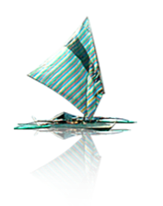

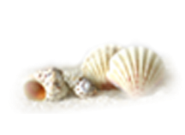
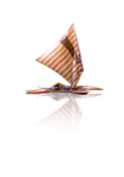


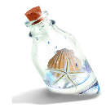
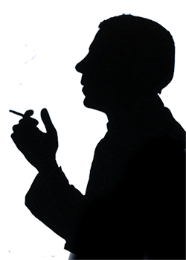

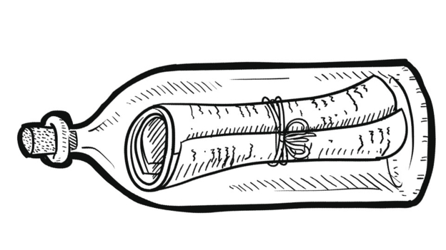




Conflict 3:A drifting bottle promised me a new friend, but where to find?
Conflict2:Father was silent, even about my birthday
Conflict1: Move to a small seaside house with a few things

Slide 10
Paragraph 1：I stared at the paper and then looked around.
Paragraph 2：As I opened my eyes, I found my father standing right beside me.
theme？

Slide 11







solution
Solution 1:Father broke silence to celebrate my birthday/ love between family members
Solution3: 什么是幸福？
A small house full of love is is enough as for happiness 。
Solution2: I found an unusual new friend.
father or sth else ?

Slide 12

I closed my eyes
I opened my eyes

Slide 13
Predict the development
Paragraph 2：As I opened my eyes, I found my father standing right beside me.
为什么闭眼？
睡觉？
昏厥？
有人告诉我闭眼？
谁呢？爸爸吗？还是漂流瓶的纸条？
我自己闭眼释放情绪？
在何时何地闭眼？
爸爸来干什么？（与生日有关？）
如何解决问题？新朋友是什么？
有爱的关怀（爸爸），内心的满足和平静（大海？海边的小房子）

Slide 14
Predict the development
Paragraph 1：I stared at the paper and then looked around.
我看到了/听到了什么？
不远处弟弟妹妹们的欢乐？
爸爸的身影？
海浪？海风？贝壳？小房子？

Slide 15
Predict the development
Paragraph 1：
I stared at the paper and then looked around.
Paragraph 2：
As I opened my eyes, I found my father standing right beside me.
What did I want to see? What did I see?
How did I feel?
Did I believe the words on the paper?
Did it change my emotion?
I must have closed my eyes. What happened?
When was my father there?
What would he say or do?
Finally did I receive any birthday cards or presents?
Did I get a new friend?

Slide 16
Possible problems in students’ writing:
阅读不到位，文章基调和主题把握不准。
例如1：瓶子里的字条已经看过了。有些同学仍在第一段提到打开瓶子看到字条，还增加了一张“寻宝图”。
例如2：又有好几个瓶子浮上来，每一个都有新的内容。
情节设置缺乏逻辑性，上下文不够连贯。
例如：“闭眼”情节的想象五花八门：有被太阳晒晕了，走着就睡着了。有被海浪卷到大海了，昏了。有被岩石绊倒，摔晕了。然后爸爸来救我，或者爸爸突然出现，道歉，送礼物，至于那只瓶子，则再也没有出现过。

Slide 17





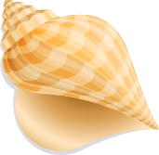
以Zoe下水作文解决三种矛盾解决方式以及两段之间衔接
Paragraph 1
I stared at the paper and then looked around. In the near distance came the joyful laughter of Carol and Julie, seemingly having found some extraordinary shells out of their expectation, and at my foot, the waves of tide kept touching the rock periodically. Not a single magic or any sign shew. I lowered down my head and glued my eyes to the rest of the paper. “All you need to do is close your eyes for ten minutes,” read the paper. So I did, with a strong curiosity to guess who this promised friend would be. Slowly, I felt the gentle breeze on my face, combing through my hair, which helped clear my thought. Far from the busty and noisy city, I realized that it was a quiet and lovely place that my father brought us to actually.
cohesion
Solution1: A small house doesn’t mean a small life.

Slide 18
以Zoe下水作文解决三种矛盾解决方式以及两段之间衔接
Paragraph 2
As I opened my eyes, I found my father standing right beside me. How did he come to my side unnoticeably? I searched for an answer on his still gloomy face, while holding the paper tightly. Father broke the silence first. “Sorry, ” he relieved a sigh. “ I know it is your birthday, but I can’ t afford you any presents. You know…” I briskly cut his words by replying “Don’t say that, Daddy. You have provided us with everything, always. Just now I found a new friend at this beach.” Startled by my answer, father asked in astonishment “So soon? Who is this friend?” I chuckled at his abrupt reaction “I found at my heart rests a quiet soul who prefers the vast and deep ocean to be a friend.” Solution3: I found an unusual friend
Solution2: Father broke the silence and admitted my birthday
Solution3: I found an unusual friend

Slide 19
I stared at the paper and then looked around. I was cold. Although I could not see my sisters nor the new house, which was hidden from my sight by a grey wall, I got the feeling that I was not alone. Walking along the shore was a tall familiar figure who looked lost in his thoughts. I looked again at the paper in my hand, closed my eyes and wished.
As I opened my eyes, I found my father was standing right beside me. “Happy Birthday, son,” he said, patting my shoulder gently. I smiled up at him and took his hand. Looking back, life from that day on marked the start of a close bond and a strong friendship with my father. What was my birthday surprise? Wishes do come true.

Slide 20
Possible version 2
I stared at the paper and then looked around. On the backside, there was a map. I noticed that it was clearly leading me in a direction, but who could have sent this? I stood there in silence and studied it. I decided to follow the map and it led me down the beach until I reached a staircase. I looked back and could no longer see my siblings. I continued to follow the point on the map, until I unexpectedly lost my footing and fell down the steps.
As I opened my eyes, I found my father was standing right beside me.“Happy Birthday, son,” he said, patting my shoulder gently. Then he asked how I had come upon this place? I explained to him that I had found the bottle in the ocean and when I opened it had the words on it. Shocked by the message, my father realized what I had found. “I threw this bottle into the ocean many years ago when I was alone.” he said. “I used to come to this exact place to get away from everyone else. Now I get to share this experience with you.” What a birthday surprise!

Slide 21
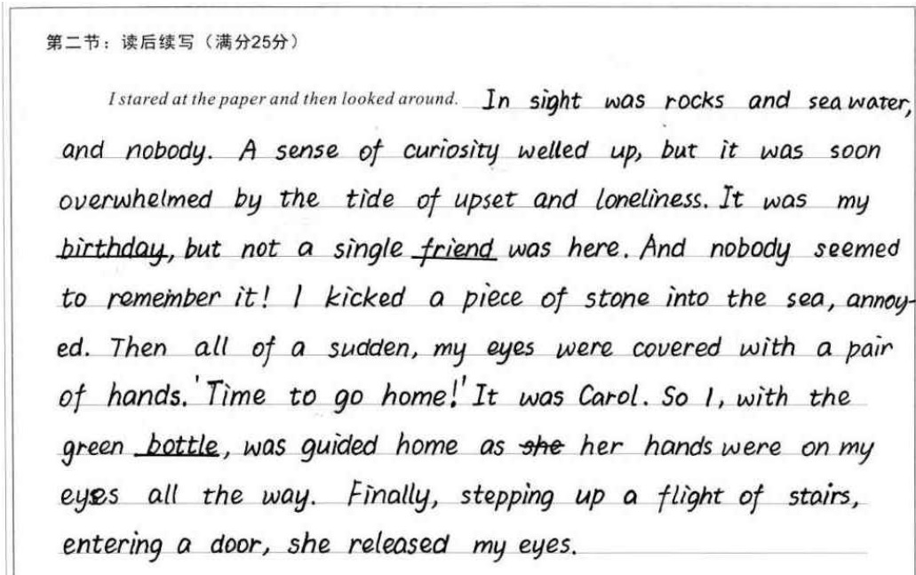
Example of reasonable development:
点评：
本段的续写与首句衔接融洽，从所见（空旷无人），到所感（寂寞失落），到Carol出现（蒙眼领我回家），情节设置合理，为下一段中问题的解决和主题的总结作了恰当的铺垫；语言上心理活动、动作描写到位，语言的积累和运用还是不错的。

Slide 22
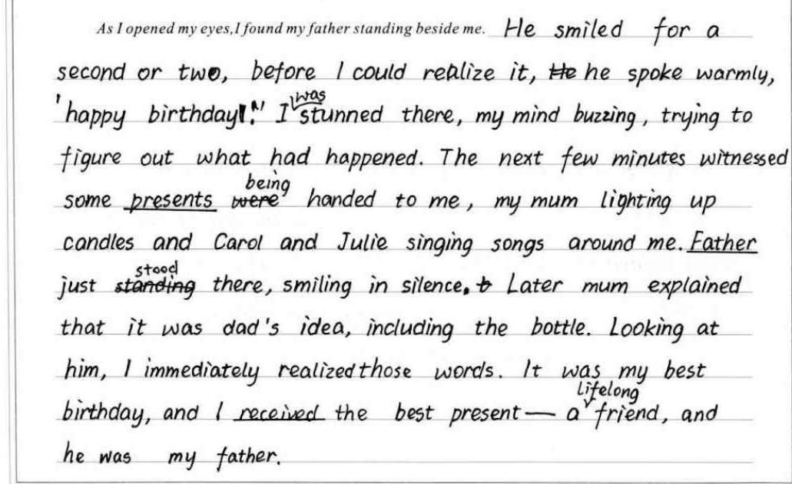
Example of reasonable development:
点评：
本段在情节上解决了birthday和friend的问题，紧扣主题，语言上对无灵主语、非谓语的使用值得赞赏。另外，作者在结尾呼应上文，交待了bottle的由来（此处不是非常合理），把father- friend- present都串了起来（还是略显生硬），但在考场上能对所有因素都有所兼顾，已实属不易。

Slide 23






课后巩固练习--Action
1. 寻找一些不寻常的贝壳
1.search for unusual shells
2.不停地接触岩石
2. keep touching the rock periodically
3.低下头来
3. lower down one’s head
4.眼睛盯着
4. glue my eyes to
5.梳理头发
5. comb through the hair
6.拍肩膀
6. pat one’s shoulder
7.打破沉默
7. break silence
8.沿着海岸走
8. Walk along the shore

Slide 24
课后巩固练习—Emotion
1. 欢快的笑声
1.the joyful laughter
2.意料之外
2. out of expectation
3.强烈的好奇心
3. a strong curiosity
4.不被注意
4. unnoticeably
5.松一口气
5. relieve a sigh
6.轻快地打断他的话
6. briskly cut his words
7.被我的回答吓了一跳
7. startled by my answer
8.对他的唐突反应咯咯直笑
8. chuckle at his abrupt reaction

